Slide 1
Cansolair Efficiency Monitoring System
Progress Update by: Dylan Stone

Slide 2

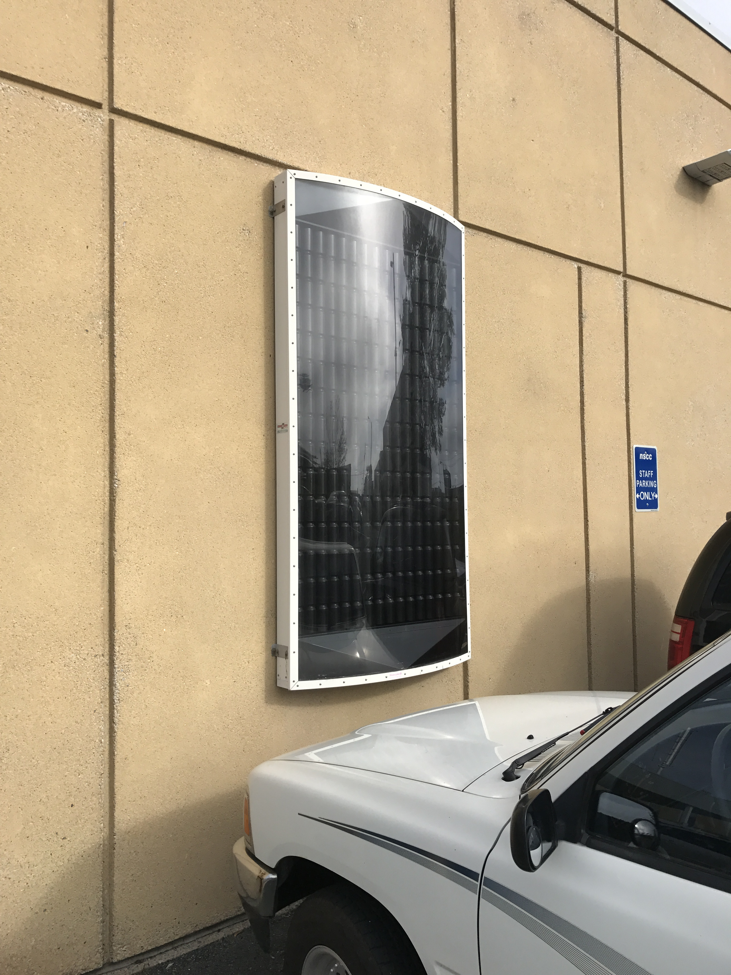
Cansolair
30 Year old Canadian company
This solar heater is their primary product
Solar Air Heater
Uses the sun to heat internal air
Uses a fan to circulate the air through the system
Located at NSCC
$2000+

Slide 3
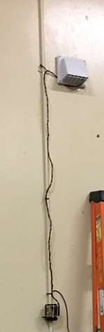

Monitoring System
Power Calculation
Flow Rate
Temperature Differential
$$Energy (kJ)=Heat Capacity\left(\frac{kJ}{kg℃}\right)∗Mass \left(kg\right)∗Temperature Differential (℃)$$
$$\left.Power\left(W\right)= 1.125∗ Flow Rate \left(LPS\right)∗Temperature Differential (℃\right)$$

Slide 4
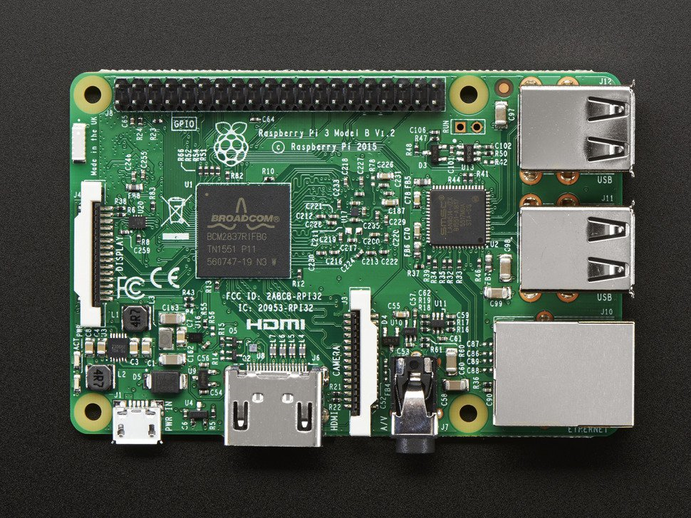
Raspberry Pi
Raspberry Pi 3
A tiny computer
GPIO header
Model with the most features

Slide 5
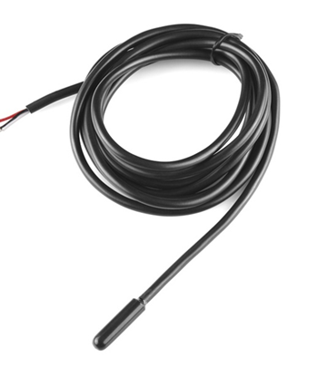
Temperature Sensors and Flow Rate
DS18B20 Digital Temperature Sensors
Accurate to a 16th of a °C
One-Wire Bus protocol
Can Be Wired in parallel
Only need Power, Ground, and Data
Flow rate was determined using a Hot Wire Flow Rate Sensor
Only need one Flow Rate measurement

Slide 6
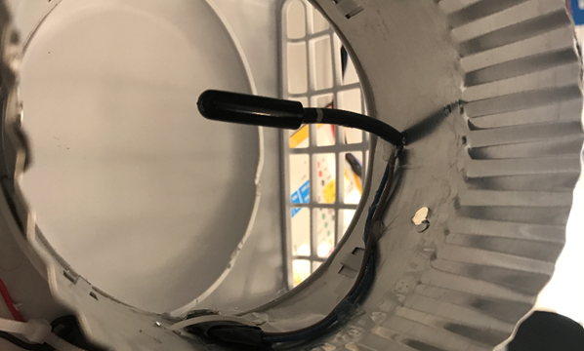
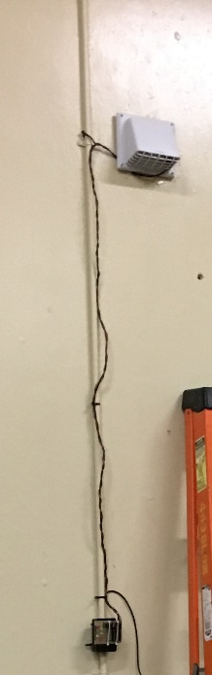
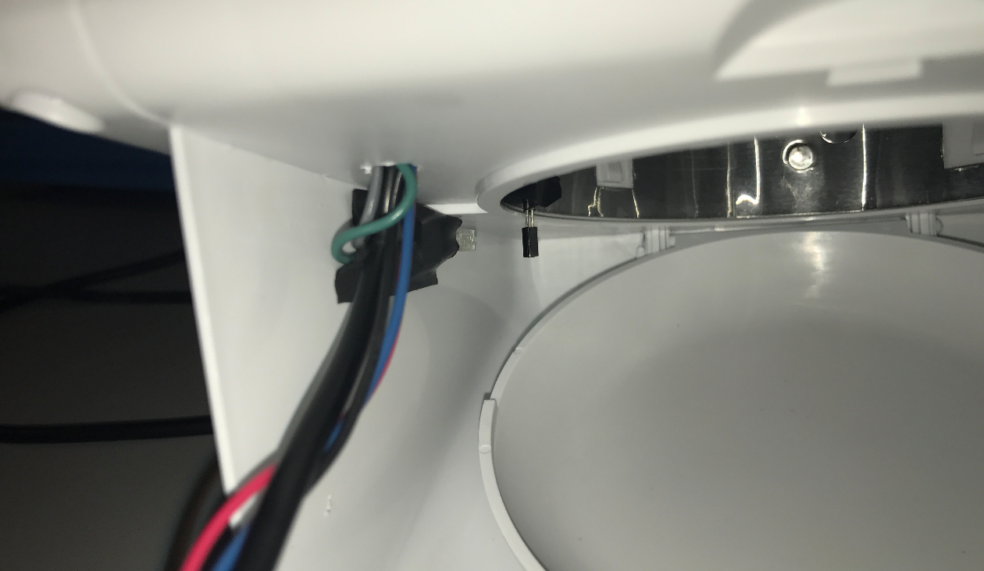
Vent And IR Sensor
Vent with flap that opens to exhaust air
Infrared sensor across the flap
Outflow temperature sensor

Slide 7
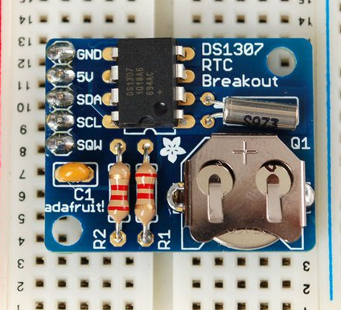
Real Time Clock
Raspberry Pi clock loses time with power
DS1307 RTC
Uses I2C Protocol
Simple to set up
Automatically syncs time
Disables Pi Clock

Slide 8
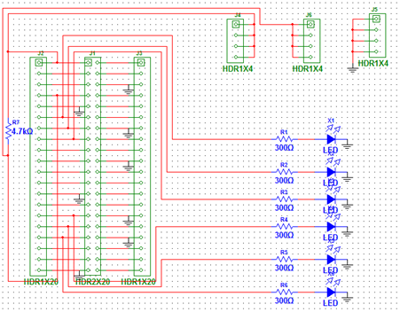
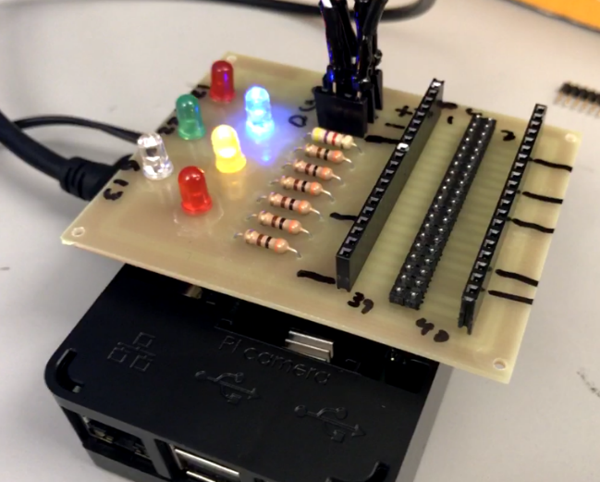
Circuit Board

Slide 9
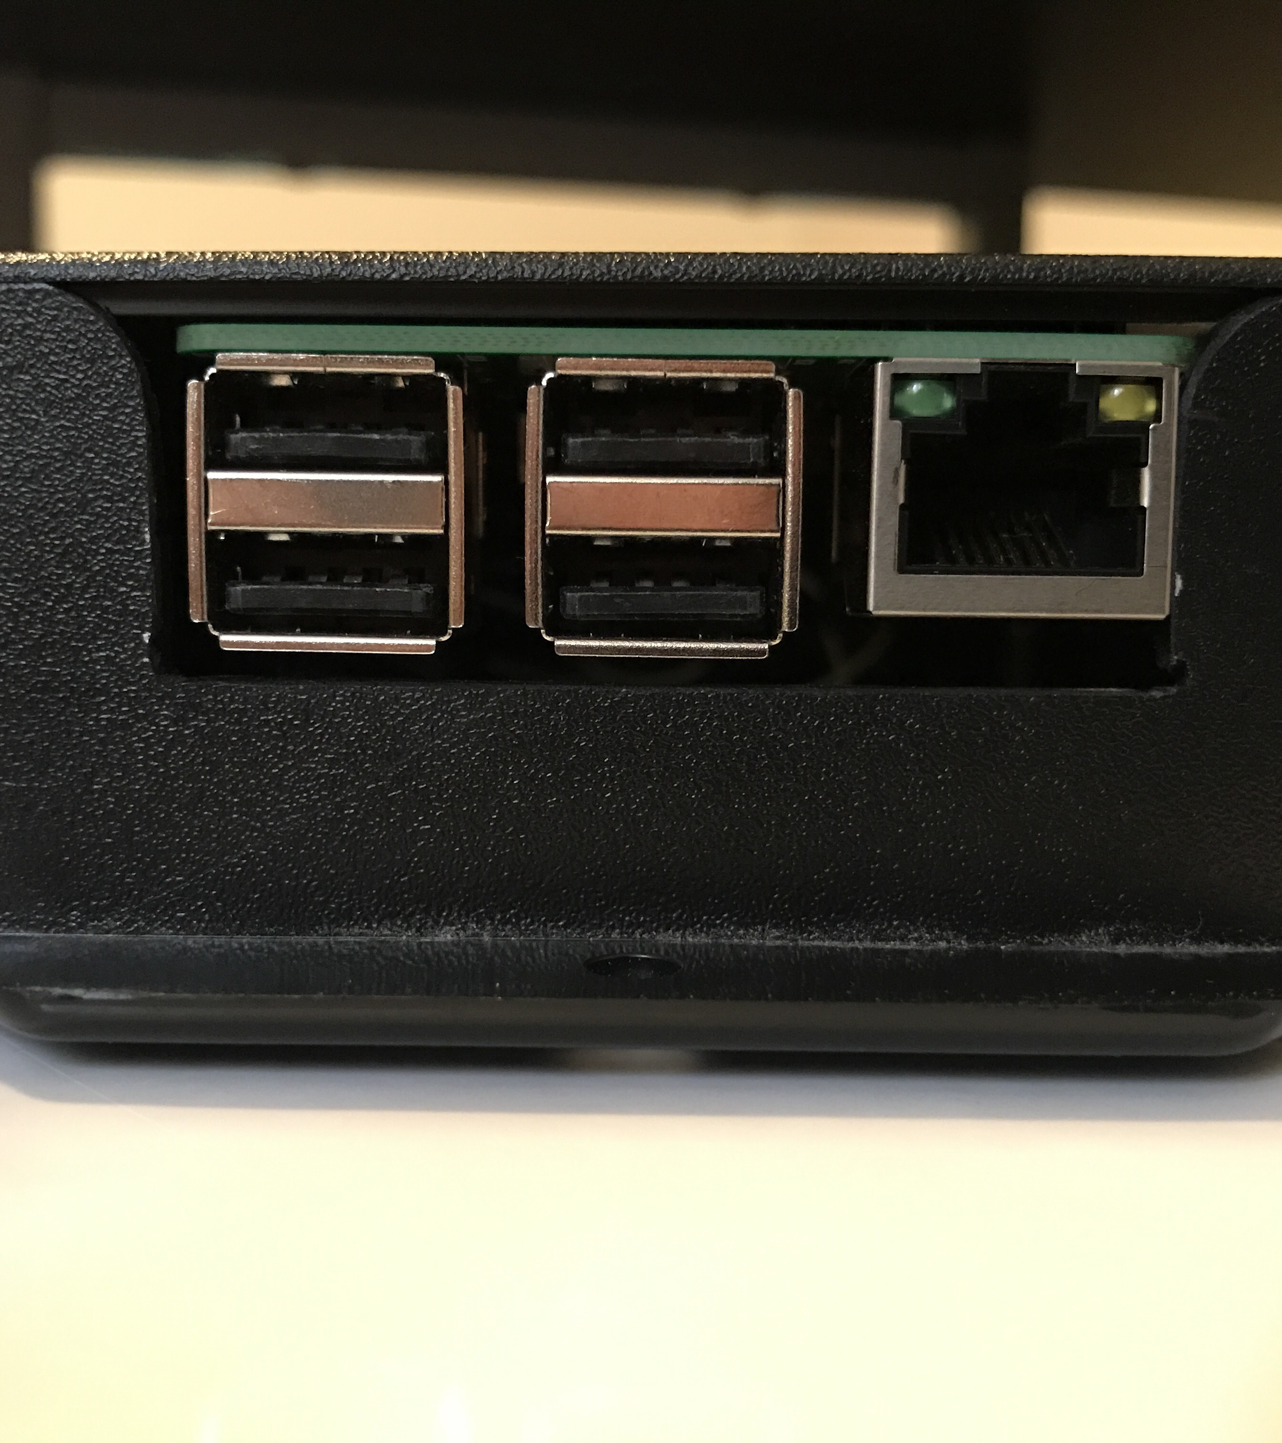
Program
Python language
Takes measurements once a minute when the vent is closed
Takes measurements about every 4 seconds when the vent is open
Calculates power and energy
Logs to a spreadsheet
Logs a second file with total kWh per day
USB Saving and flow rate adjustment
Automatically launches on boot

Slide 10
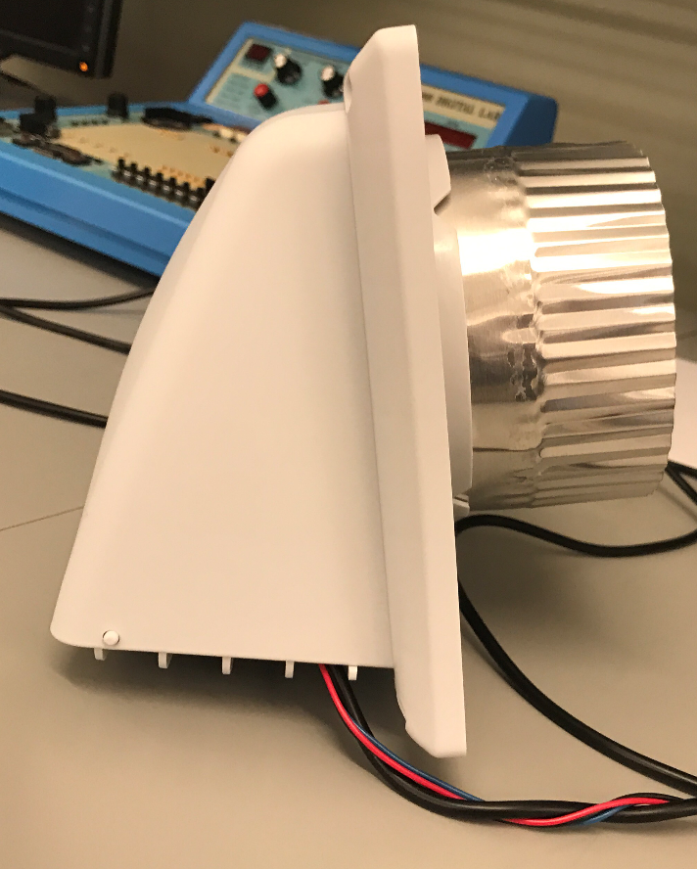
Program Flow
Read each temperature
Calculate power if the vent is open
Make a string using all the data
Save the string to a .csv file
Print the data
Checking the vent and for a USB Drive periodically

Slide 11
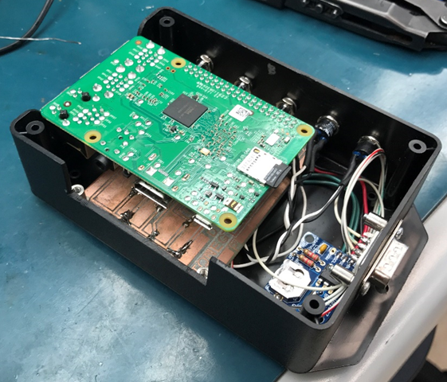
Problems Encountered
Learning to use Linux
Learning python
Flow rate
Circuit Board
USB Saving
Energy calculation time differential
Launching on boot

Slide 12
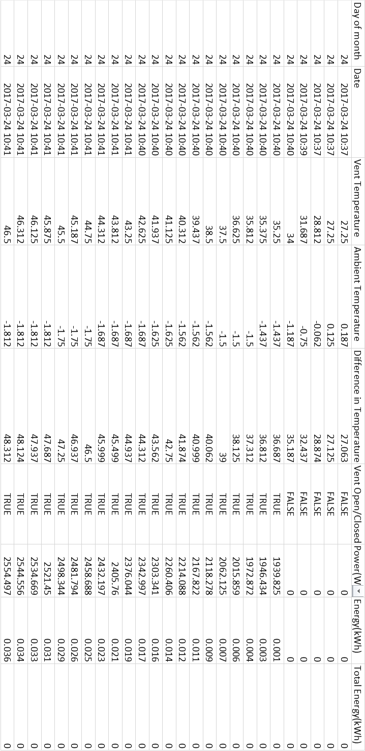
Data

Slide 13
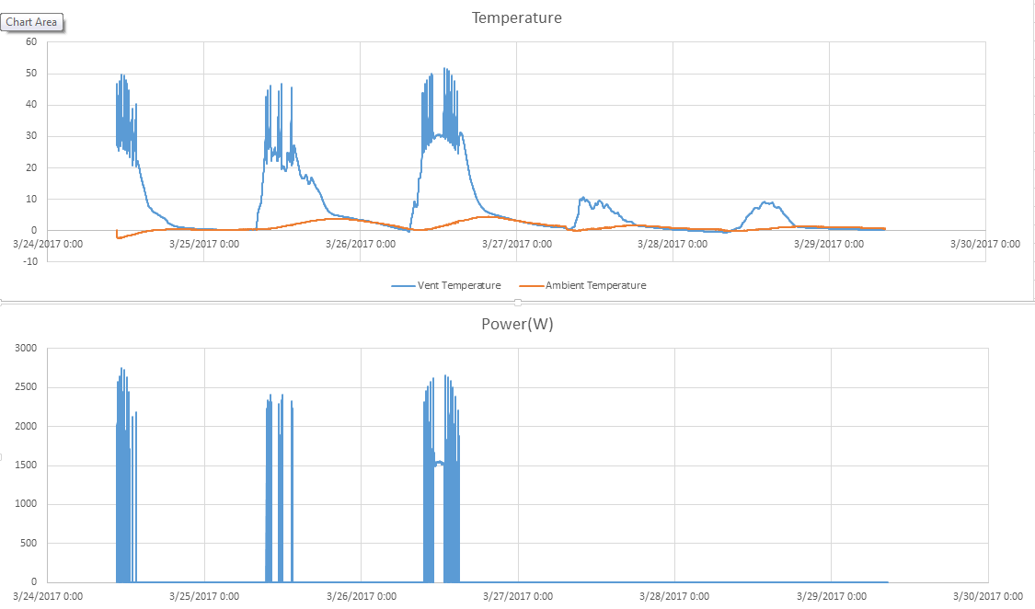
Data

Slide 14
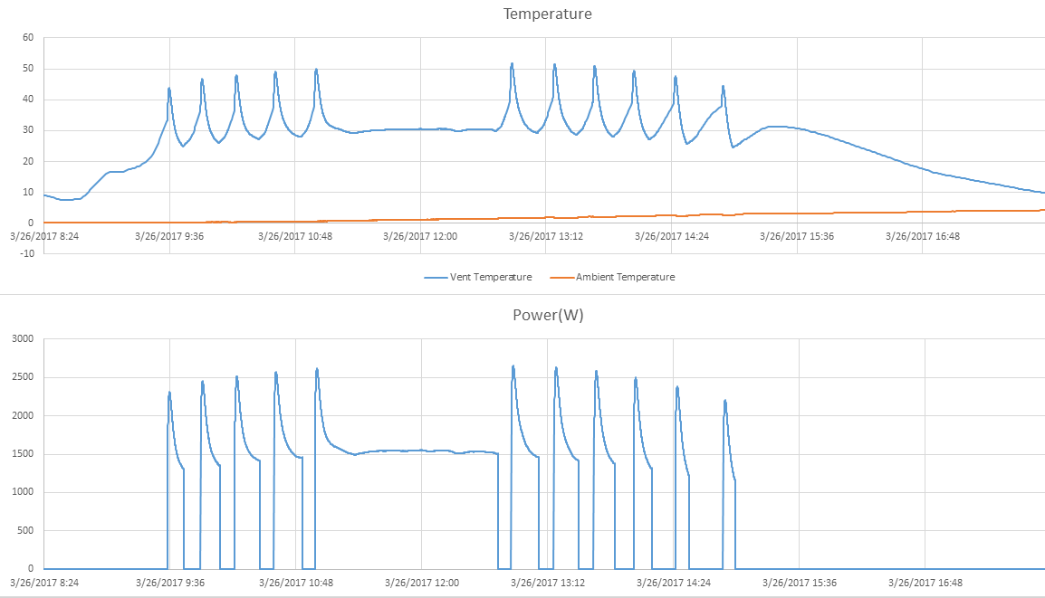
Data

Slide 15
Acknowledgements
Glenn Macleod
Steve MacCarron
Alain Joseph
James Thomson
Dale Jollimore

Slide 16
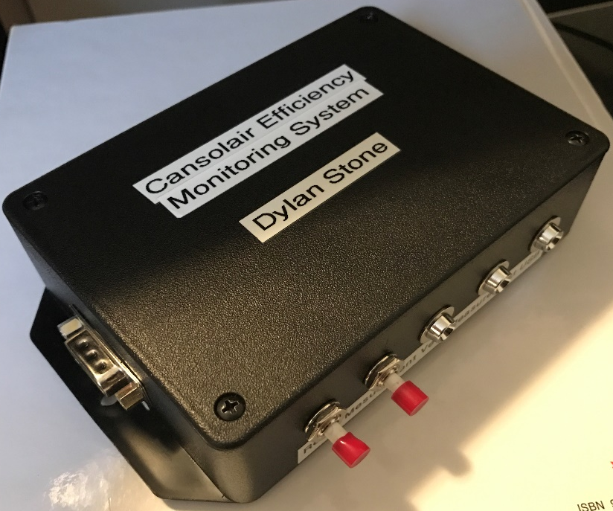
Demo and Questions

